Slide 1
SYSTEM PROGRAMMING LECTURE
Lecturer Izazullah
GPGC Charsadda

Slide 2
Virtual Machine
Virtual Machine:
Virtual Machine can be defined as an emulation of the computer systems in computing.
. Virtual Machine is based on computer architectures.
It also gives the functionality of physical computers.
The implementation of VM may consider specialized software, hardware, or a combination of both.

Slide 3
Virtual Machine
History:
Server virtualization started in the early 1960s.
IBM worked on the S/360 mainframe system to replace other computer systems that would only do one thing at a time. S/360 ran batch jobs
. On July 1, 1963, the Massachusetts Institute of Technology (MIT) announced Project MAC, funded by DARPA for research into Operating Systems, Artificial Intelligence, and Computational Theory.
MIT wanted to develop a new technology where the hardware could handle more than one simultaneous user.
IBM developed CP-40, which later evolved into CP-67 and then Unix.
Memory and other resources of the computer were divided on the time-sharing computer; hence, each user got their own computer.
Many businesses and universities started to use this Operating System.

Slide 4
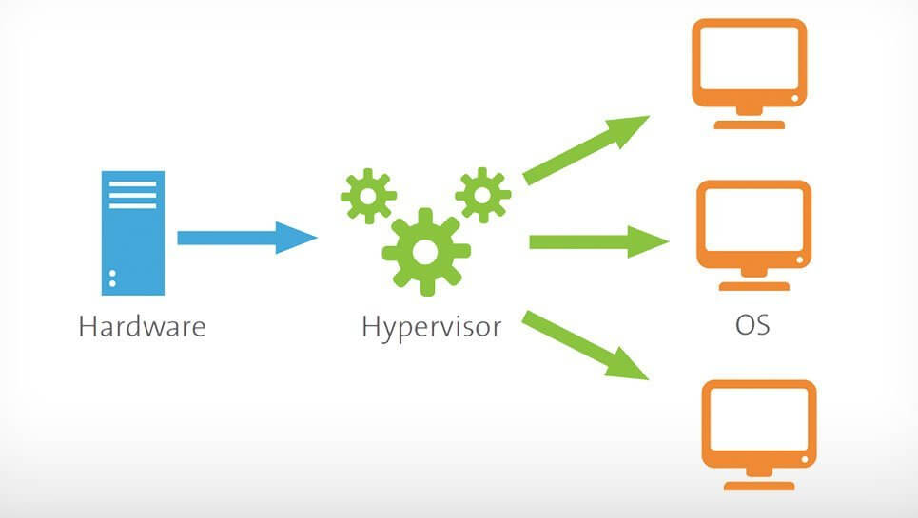
Virtual Machine
Hypervisor:
A hypervisor, also known as a virtual machine monitor or VMM. The hypervisor is a piece of software that allows us to build and run virtual machines which are abbreviated as VMs.
Hypervisors allow the use of more of a system's available resources and provide greater IT versatility because the guest VMs are independent of the host hardware which is one of the major benefits of the Hypervisor.

Slide 5
Virtual Machine
Types of Hypervisor:
There are mainly two types of Hypervisor.
TYPE-1 Hypervisor:
The hypervisor runs directly on the underlying host system. It is also known as a “Native Hypervisor” or “Bare metal hypervisor”. It does not require any base server operating system. It has direct access to hardware resources.
Example:
Examples of Type 1 hypervisors include VMware ESXi, Citrix XenServer, and Microsoft Hyper-V hypervisor.

Slide 6
Virtual Machine
TYPE-2 Hypervisor:
A Host operating system runs on the underlying host system. It is also known as ‘Hosted Hypervisor”.
Such kind of hypervisors doesn’t run directly over the underlying hardware rather they run as an application in a Host system(physical machine). Basically, the software is installed on an operating system. Hypervisor asks the operating system to make hardware calls.
Example:
An example of a Type 2 hypervisor includes VMware Player or Parallels Desktop.

Slide 7
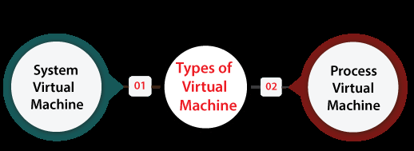
Virtual Machine
Types of Virtual Machine:
There are distinct types of VM available all with distinct functionalities:

Slide 8
Virtual Machine
System Virtual Machine:
These types of virtual machines are also termed as full virtualization VMs.
It facilitates a replacement for an actual machine.
These VMs offers the functionality required for executing the whole operating system (OS). A hypervisor applies native execution for managing and sharing hardware.
It permits for more than one environment that is separated from each other while exists on a similar physical machine.
Novel hypervisor applies virtualization-specific hardware and hardware-assisted virtualization from various host CPUs primarily.

Slide 9
Virtual Machine:
Process Virtual Machine:
These Virtual Machines are created for executing several programs of the computer within the platform-independent environment.
process virtual machine is sometimes known as MRE (Manages Runtime Environment) or application virtual machine.
It runs as a general application in the host operating system and supports an individual process. These are created if that process begins and destroyed if it exits.

Slide 10
Virtual Machine
Process Virtual Machine:
he process virtual machine has become famous with the Java programming language.
It can be implemented with the Java virtual machine.
Another example includes the .NET Framework and Parrot virtual machine which executes on the virtual machine known as the Common Language Runtime.
Each of them could be served as the abstraction layer for a computer language.

Slide 11
Virtual machine
Advantages:
There are no protection problems because each virtual machine is completely isolated from all other virtual machines.
Virtual machine can provide an instruction set architecture that differs from real computers.
Easy maintenance, availability and convenient recovery.

Slide 12
Virtual Machine
Disadvantages:
When multiple virtual machines are simultaneously running on a host computer, one virtual machine can be affected by other running virtual machines, depending on the workload.
Virtual machines are not as efficient as a real one when accessing the hardware.

Slide 13
THANK YOU

